Slide 1
Electocardiography
Prepared by
Dr. Adnan T. Al Bajalan
M.B.CH.B (Suli Univ.) , MSc in cardiology (Ain shams univ. )
2023-2024

Slide 2
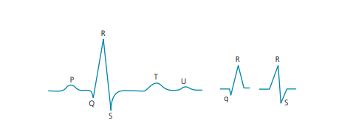
Figure 1: P–QRS–T complex. P wave represents the atrial depolarization and includes a part of the AV nodal conduction. PR interval consists of P wave
and AV conduction. QRS complex represents ventricular depolarization. ST–T segments represent ventricular repolarization. The normal U wave is a diastolic wave related to the mechanical stretch of the myocardium .

Slide 3
Normal calibration:
• Height of one small box =1 mm=0.1 mV. One big box =5 small boxes=0.5 mV.
• Width of one small box =1 mm=0.04 seconds. One big box =5 small boxes=0.2 seconds (sweep speed: 25 mm/s).

Slide 4
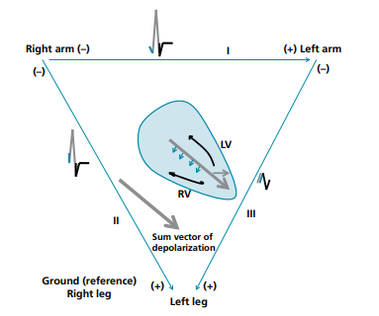
Figure 2: Illustration of how the electrical depolarization spreads in the heart (frontal plane, bipolar limb leads). The blue arrows represent the left‐to‐ right septal depolarization. The gray arrow is the main axis of depolarization along the septum towards the LV and apex. The black arrows represent the late depolarization spreading towards the base. The QRS deflections that correspond to each one of these depolarizations are colored likewise. The QRS complex in each lead represents how the electrical activity is spreading in relation to the lead. The septal depolarization (blue) explains the normal small q wave seen in normal individuals in lead I, other limb leads (sometimes), and left precordial leads. The basal depolarization explains the late “s” wave in those leads. The main deflection (big R or big S) is explained by the main depolarization spread.

Slide 5
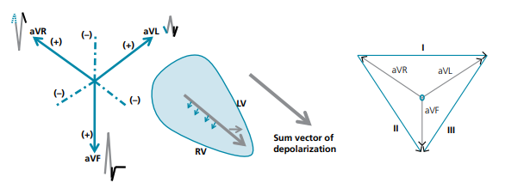
Figure 3: Illustration of how electrical depolarization spreads in the heart (frontal plane, unipolar limb leads). In order to catch cardiac activity, the axis of the lead should traverse near the heart; as such, no cardiac activity is detected when both poles are placed on the legs.

Slide 6
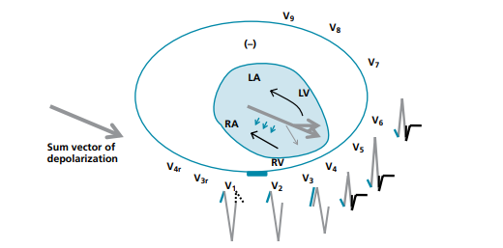
Figure 4: Illustration of how electrical depolarization spreads in the heart (horizontal plane, unipolar precordial leads). V1 and V2 overlie the right heart and the septum, whereas V4 through V6 overlie the apex and the LV. The QRS complex starts as rS in leads V1 –V3 and progresses to qRs in the left leads. The small r in V1 –V2 and the small q past the transition zone (V4 –V6 ) represent septal depolarization. At the transition zone (e.g., V3 in this picture), the R wave represents septal depolarization and part of the main axis of depolarization.

Slide 7
Since leads V1 and V2 overlie the right heart, any abnormality that makes electrical forces go towards the right heart makes QRS positive in V1 or V2 , this is the case in RBBB and RVH.
Conversely, any abnormality that makes electrical forces go towards the left makes QRS positive in V5 or V6 , this is the case in LBBB and LVH.
V1→4th intercostal space, right sternal border.
V2→4th intercostal space, left sternal border.
V4→5th intercostal space, midclavicular level.
V3→between V2 and V4 .
V5→5th space, anterior axillary line.
V6→5th space, midaxillary line.
V7→posterior axillary line
V9→paraspinal line
V8→between V7
V9 (~ below the scapula)

Slide 8
# Stepwise approach to ECG interpretation The following steps are followed in ECG interpretation:
1. Rhythm: look at QRS regularity and rate.
•Then look for P waves, and assess the P–QRS relationship.
• Determine if the rhythm is sinus (P [+] in I and II and [–] in aVR).
2. Determine QRS axis in the frontal plane (leads I, II, and aVF). Also assess R‐wave progression in V1 –V6 (normal vs. poor progression vs. early transition)
.Then start analyzing each ECG segment:
3. Analyze P wave in leads II and V1 –V2 (left or right atrial enlargement).
4. Analyze PR interval.
5. Analyze QRS width: if≥120 ms, look at the QRS morphology in the right leads V1 –V2 and the left leads V5 –V6 , and characterize it as RBBB (wide upright QRS on the right, V1 –V2 ), LBBB (wide upright QRS on the left, V5 –V6 ), non‐specific conduction delay, or pre‐excitation (WPW).
6. Look for abnormal Q waves.
7. Analyze ST–T segments. Are they depressed or elevated? In which leads and which family?
• In case of ST depression, does the abnormality appear secondary to LVH/LBBB/RVH/RBBB and is it opposite to the QRS direction? Or does it appear ischemic?
• In case of ST elevation, does the abnormality appear secondary to LVH/LBBB and is it opposite to QRS direction? Is it concave upward without reciprocal changes or Q waves (this may suggest pericarditis or secondary ST elevation)? Is PR segment depressed?
8. Assess QT segment. Look for patterns of electrolyte abnormalities

Slide 9
# Rhythm and rate
A.Look at the rhythm strip and survey for the following:
1. Assess the regularity of QRS complexes. Then look for P waves and assess the P and QRS relationship.
Examples of cardiac rhythms:
a. Sinus rhythm or tachycardia: one sinus‐looking P wave before each QRS .
b. Atrial tachycardia, atrial flutter: one or more P waves are seen before each QRS with consistent P–QRS association. R–R intervals are equal or, if not equal, there is a consistent repetition of the same pattern of R–R intervals.
c. Atrial fibrillation: irregularly irregular rhythm or tachycardia (total chaos; no repetition of the same R–R intervals; Another irregularly irregular rhythm is MAT. Unlike AF, in MAT, polymorphic P waves are seen and conduct in a 1:1 fashion.
d. AVNRT/AVRT: regular, narrow complex tachycardia. P waves are not seen or are seen just after or within ST–T, with a 1:1 QRS–P association.
e. Ventricular tachycardia: wide complex tachycardia with no relation between P waves and QRS complexes (AV dissociation) and/or more QRS complexes than P waves .
f. Bradycardia with regular P waves and regular QRS complexes, unrelated to each other: complete AV block
g. Bradycardia without any P wave: sinus arrest with junctional escape rhythm, AF with complete AV block and junctional escape rhythm, or hyperkalemia.

Slide 10
2. Premature ventricular or atrial complexes (PVCs or PACs). PVC is wide with ST–T directed opposite to QRS. PAC is narrow, but may be wide in case of aberrancy
3. Irregular rhythm with some pattern or regularity, meaning that R–R intervals are not all equal, but some of them are:
• Atrial tachycardia or atrial flutter with variable AV conduction (e.g., conduction changes from 2:1 to 3:1, then 2:1 again). The rhythm is irregular, but there is a pattern to it.
• PVCs or PACs (PVCs and PACs are usually followed by a pause).
• Sinus arrhythmia (P–P interval varies cyclically, PR distance remains constant).
4. Groups of beats separated by pauses:
• Second‐degree AV block
• Frequent PACs, PVCs, or non‐conducted premature Ps, each followed by a pause
5. Look for pacemaker spikes (small vertical lines before P or QRS or both P and QRS)

Slide 11


Regular QRS rhythm with a P wave before each QRS complex: sinus tachycardia or atrial tachycardia. Analyze P morphology in leads I, aVR, and II to determine if the rhythm is sinus or ectopic atrial
Irregular tachycardia with no repetition of any R–R pattern. No clear P wave is seen; rather, waves that vary greatly in shape are seen. This is AF with fibrillatory atrial waves
Narrow complex tachycardia with a pseudo‐r’ in lead V1 that represents a retrograde P wave (arrows). This is a narrow complex tachycardia with a very short interval between QRS and the retrograde P wave→AVNRT

Slide 12


Wide complex tachycardia: VT vs. SVT with bundle branch block. Look for P waves on top of the ST–T segments: one can identify deflections that have a consistent morphology and timing and that can be marched out. They occur after every third QRS. Since the number of QRS complexes>number of P waves, this is VT. The P waves are retrograde P waves
Bradycardia with regular P waves and regular QRS complexes, unrelated to each other. Some P waves fall on top of the ST–T segments and manifest as notches. This is a third‐degree AV block. If P wave occasionally conducts, the QRS rhythm would have some irregularity

Slide 13

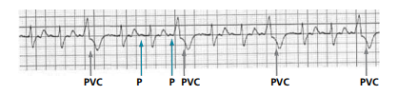
Severe bradycardia with regular P waves and regular QRS complexes, unrelated to each other: third‐degree AV block
Irregularity with a pattern. Wide premature complexes with ST–T changes opposite to QRS are seen; these occur in a trigeminal pattern. A wide premature beat is typically a PVC

Slide 14
B. Calculate the ventricular rate
The ventricular rate is equal to 300 divided by the number of big boxes between two QRS complexes. If the rhythm is irregular (e.g., AF), count the number of QRS complexes in 3 seconds (15 large boxes), then multiply this number by 20; or count the number of QRS complexes on the standard 12‐lead ECG run (10 seconds) and multiply it by 6.
C. The rhythm is sinus if P wave is upright in leads I, II, and aVF and inverted in lead aVR
Also, a sinus P wave is typically biphasic (positive then negative) in V1 and V2 , but sometimes entirely positive in V1 –V2 or entirely negative in V1 . A sinus P wave is always upright in V3 –V6 .

Slide 15
IV. QRS axis in the limb leads and normal QRS progression in the precordial leads
Determine the frontal QRS axis by looking at the net QRS voltage
The normal QRS axis is between –30° and +90°. To determine QRS axis, start by looking at leads I and aVF. If the net QRS is negative in lead aVF, the axis is< 0 in leads I, II, and aVF.
Right-axis deviation : If the net QRS is negative in lead I and upright in lead aVF.
Left‐axis deviation : If the net QRS is upright in lead I but negative in leads II and aVF.
If the net QRS is negative in leads I and aVF, the axis is in the northwest quadrant (extreme right or left deviation).

Slide 16
*Causes of right-axis deviation:
• RVH
• Lung disease
• Left posterior fascicular block (LPFB)
• Lateral MI
• Normal variant: in young individuals
• Arm electrodes misplacement: P wave will also be negative in lead I, and upright in lead aVR
*Causes of left-axis deviation:
• LVH
• Left anterior fascicular block (LAFB)
• Left bundle branch block (LBBB)
• Inferior MI

Slide 17
B. Look at the normal QRS progression across V1 –V6
Normally, QRS is negative in V1 –V2 (rS) and becomes progressively positive in V5 –V6 (Rs).
Note: rS denotes small R, big S. Rs denotes big R, small S.
1. If QRS starts positive in V1 –V2 (early transition) causes :
• RVH
• RBBB.
• Posterior MI :
• WPW
2.Poor precordial R‐wave progression means that the R‐wave height remain < 3mm in lead V3 and more specifically≤1.5 mm, with failure of the R/S height ratio to increase.
• LAFB
• LVH.
• LBBB.
• COPD

Slide 18
V. P wave: analyze P wave in leads II and V1 for atrial enlargement, and analyze PR interval .
Lead V1 (and/or V2 )
• Left atrial enlargement=terminal negative P‐wave deflection>1 box wide (40 ms) and 1 box deep (0.1 mV).
• Right atrial enlargement=initial positive P‐wave deflection≥1.5 small boxes high.
Lead II (and I, III) P waves should be < 2.5 small boxes high and < 3 small boxes wide
• Left atrial enlargement=P wave≥120 ms and notched P may have a negative terminal deflection in leads III and aVF.
• Right atrial enlargement=P wave is peaked≥0.25 mV
C. Normal PR interval : Normal PR interval is 120–200 ms (3–5 small boxes)

Slide 19
VI. Height of QRS: look at the height and the width of QRS in leads V1 , V6 and I–aVL.
Look for LVH
• In lead I, R wave>14 mm, or R wave in lead I+S wave in lead III>25 mm.
• In lead aVL, R wave>11 mm or>13 mm in case of LAFB (very specific criterion).
• S wave in V3+R wave in aVL≥28 mm in men or≥20 mm in women
• In the precordial leads: big R on the left (V5 –V6 ) and big S on the right (V1 –V2 ).
B. Look for RVH
Right‐axis deviation (net QRS [–] in lead I, [+] in lead aVF)
Big R wave in the right lead V1 (≥7 mm), or big S wave in the left leads V5 –V6 (≥7 mm) Or big R>S in V1 , big S>R in V6 , or small S in V1≤2 mm
Or R in V1+S in V6>10.5 mm

Slide 20
VII. Width of QRS. Conduction abnormalities: bundle brunch blocks –
-The normal QRS duration is < 110 ms,
-In complete bundle branch block, the QRS is wide ( > 120 ms or 3 small boxes )
-In incomplete bundle branch block, the QRS is 110–119 ms.
Look at the QRS complex in lead V1 . Is the net QRS complex upright (i.e., positive)?
• If yes, consider RBBB.
• If no (negative QRS in lead V1 ), consider LBBB.

Slide 21
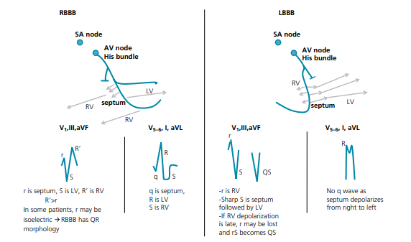
In RBBB, the vector of depolarization spreads from the left septum to the right and left ventricles. RSR’ is seen in V1 , R being septal depolarization, S being LV depolarization, and R’ being the late RV depolarization. RS is seen in V6 , R being LV depolarization, and the wide S being the slow RV depolarization. In LBBB, the vector of depolarization spreads from the right septum to the left septum and the left ventricle. The vector looks toward V6 and away from V1 . Thus, in LBBB, QRS is positive in V5 –V6 and widely negative in V1 . The septal q wave that is normally seen in the left lateral leads is lost, as the septum depolarizes from the right to the left. The presence of any q wave in leads V5 –V6 or lead I is not typical of LBBB and suggests an old MI. Only rarely, a q wave may be seen in lead aVL.

Slide 22
A. RBBB In RBBB, QRS has a slurred positivity in the right leads. Beside QRS≥120 ms, both the following two criteria are required to make the diagnosis of RBBB:
• rSR’, rsR’, or rsr’ pattern in the right leads V1 and/or V2 . R’ is usually wider and taller than the initial R wave. A qR pattern may replace rSR’ in lead V1 when the initial r wave is isoelectric. A single wide R wave, often notched, may be seen instead of rSR’.
• A wide S wave in the left leads I and V6 . S wave must be wider than R wave or wider than 40 ms. In addition, T‐wave inversion in V1 –V2 is common but not mandatory (T directed in an opposite direction to QRS)

Slide 23
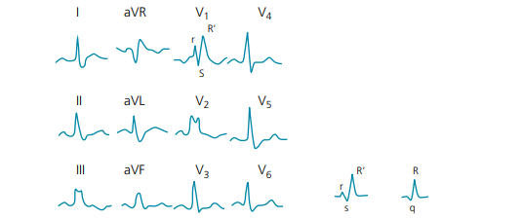
RBBB. rSR’ is seen in V1 , notched R wave is seen in V2 , and rsR’ and qR patterns are shown on the right (rsR’ means small R, small S, big R’). Any of those patterns is consistent with RBBB in V1 –V2 . S wave is wide and slurred in leads I, aVL, and V5 –V

Slide 24
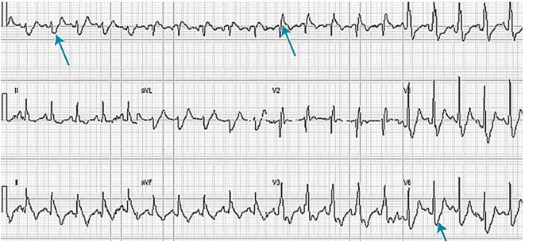
Sinus tachycardia with RBBB (rSR’ in V1 –V2 , wide and slurred S in V5 –V6 and I–aVL, arrows)

Slide 25
B. LBBB
In LBBB, QRS has a slurred positivity in the left leads.
The four criteria are required to make the diagnosis of LBBB:
Wide notched R wave in leads I, aVL, and V5 –V6 (M‐shaped or slurred, plateaued R wave).
QRS is negative in leads V1 , V2 , V3 with an rS or QS pattern. QS pattern may also occur in leads III and aVF, simulating an inferior MI, but not in lead II.. QR pattern does not occur with LBBB and always implies an associated MI
The septal q wave should be absent in the left leads I and V5 –V6 The ST segment and T wave should be directed opposite to QRS. Unlike LVH, RBBB, and RVH, secondary ST–T changes are mandatory in LBBB

Slide 26
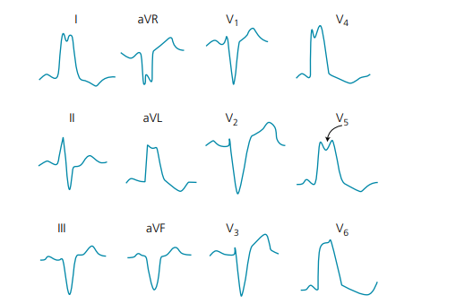
LBBB. In the lateral leads, there may be an “M‐shaped” R wave (as seen here in I and V5 ) or a broad slurred R wave (as seen in V6 ), with delayed R-wave peak time > 60 ms, measured from QRS onset to the second R notch or the end of the R plateau.

Slide 27
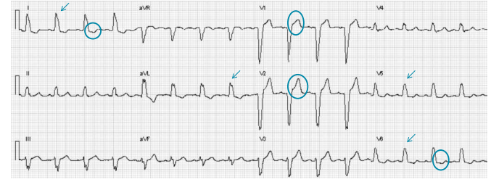
LBBB (slurred R wave in the left leads: V5 –V6 and I–aVL) (arrows). ST depression in V5 –V6 , I, and aVL, and ST elevation in V1 –V3 , directed opposite to QRS, are secondary to LBBB (circles).

Slide 28
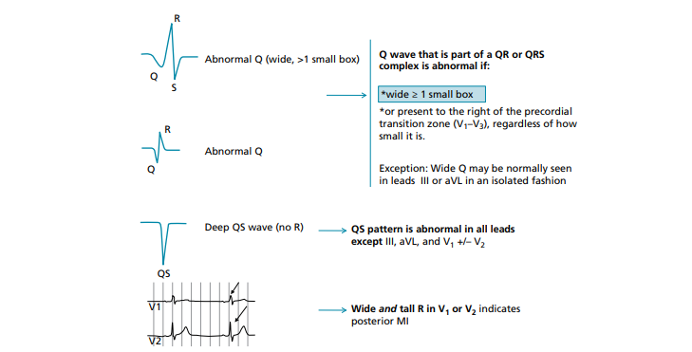
Wide Q wave (QS or QR) may be normally seen in lead III of a horizontal heart looking away from lead III. QS or QR pattern may normally be seen in lead aVL in a patient with a vertical heart that looks away from lead aVL.

Slide 29
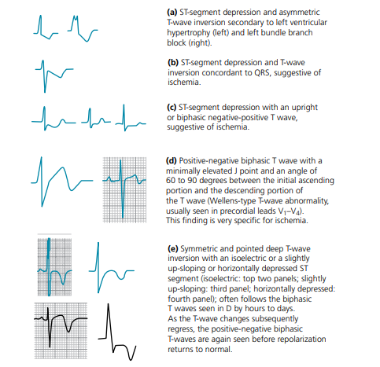
ST‐segment and T‐wave morphologies in cases of (a) secondary abnormalities and (b–e) ischemic
abnormalities

Slide 30
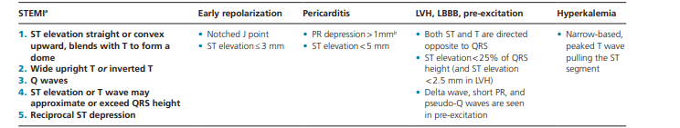

Slide 31
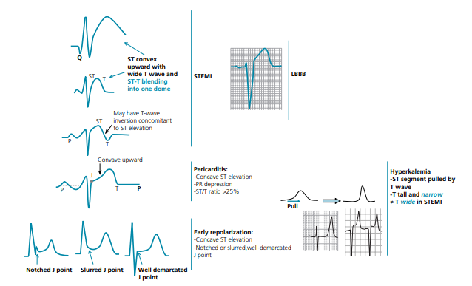
Various patterns of ST‐segment elevation

Slide 32
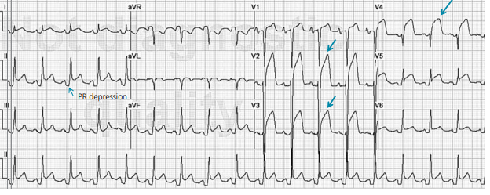
Diffuse ST elevation in~all leads and ST depression in lead aVR. This initially suggests pericarditis. PR depression in leads II, aVF, V5 , and V6 further suggests pericarditis.

Slide 33
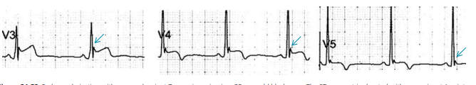
Early repolarization with a normal variant T‐wave inversion in a 33‐year‐old black man. The ST segment is elevated with a prominent J‐point notch in leads V3 –V5 (arrows). T wave is inverted in leads V4 –V5

Slide 34
Approach to tachyarrhythmias
When analyzing a tachycardia, start by looking at three features:
Narrow QRS vs. wide QRS (≥120 ms) (choose the lead where QRS is widest).
Regular vs. irregular ventricular rate.
Look for P waves and their relationship with QRS complexes.

Slide 35
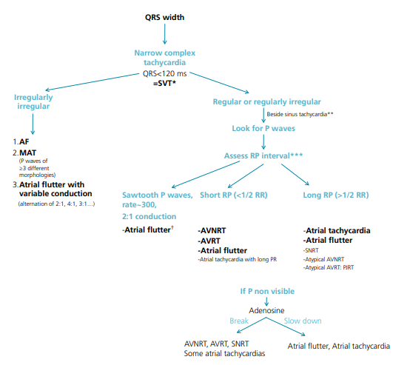
Approach to narrow QRS‐complex tachycardia

Slide 36
B. Approach to wide QRS‐complex tachycardias
A wide QRS‐complex tachycardia could be:
VT.
SVT (including AF) with aberrancy
SVT (especially AF) with pre‐excitation.
Other diagnoses: hyperkalemia; drug toxicity; ventricular pacemaker tracking an atrial arrhythmia , or pacemaker‐ mediated tachycardia.
* ~80% of wide complex tachycardias are VT (95% if CAD or HF). Thus, if one is unsure of the diagnosis, it is safer to consider the arrhythmia VT than SVT and treat it as such.

Slide 37
Features that further support VT:
• P waves are seen scattered between QRS complexes and unrelated to QRS complexes (AV dissociation), and/or number of P waves < number of QRS complexes.
• Morphology of QRS is not consistent with a typical LBBB or a typical RBBB. In patients with a wide baseline QRS, a wide QRS tachycardia that is narrower than baseline is VT.
• Tachycardia starts with a PVC rather than a PAC, and has a morphology similar to the PVC.

Slide 38
Approach to brady-arrhythmias: AV block
Identify the type but also the location of the block (nodal vs. infra-nodal block)
First‐degree AV block=PR interval>200 ms (may be as long as 1000 ms).
Second‐degree AV block
Mobitz type I (Wenckebach type): PR progressively prolongs until QRS drops.
Mobitz type II: QRS suddenly drops without a preceding PR change. The baseline QRS is usually wide. It may present as intermittently non‐conducted P waves or as one non‐conducted P wave that is not preceded by progressive PR prolongation and not followed by PR shortening. It is more ominous than Mobitz I and is almost always a distal infra-nodal AV block. It progresses to a complete infra-nodal AV block commonly and suddenly.
2:1 AV block (alternative drop of one QRS complex) could be equivalent to Mobitz I or Mobitz II AV block. If QRS is wide, the block is likely infra-nodal and is thus a Mobitz II equivalent. If QRS is narrow, the block is likely a Mobitz I equivalent.
3. Third‐degree or complete AV block: No P wave is conducted and a junctional or ventricular escape rhythm takes over. The ventricular rate is regular and unrelated to P waves (AV dissociation). The PR distance is variable yet the R–R interval is regular.
High‐grade AV block means that most P waves are not conducted and an escape rhythm is seen, but some P waves are conducted. The regular escape rhythm is interrupted by some irregularities

Slide 39
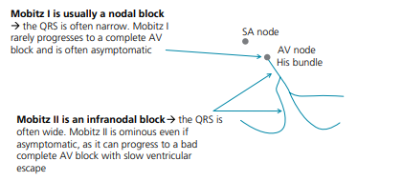
Location of the AV block.

Slide 40
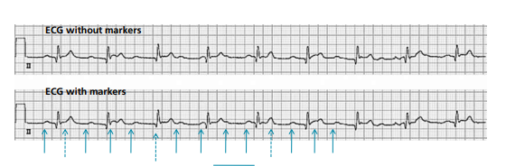
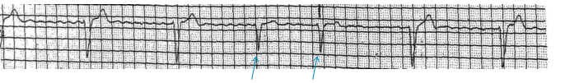
sinus tachycardia ~125 bpm with complete AV block and junctional escape rhythm
high‐grade infra-nodal AV block with ventricular escape rhythm and incomplete AV dissociation (two P waves are conducted)

Slide 41
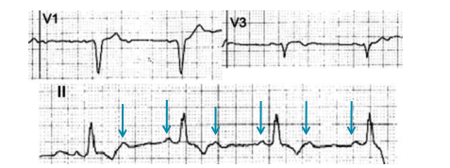
2:1 AV block

Slide 42
Thanks

